Slide 1
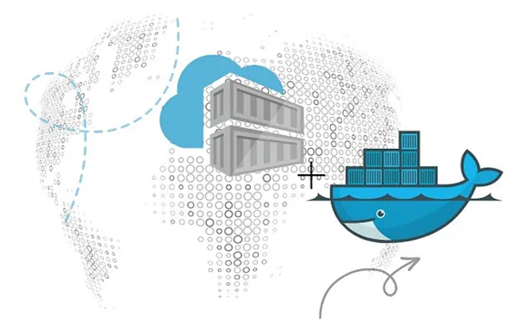
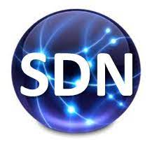
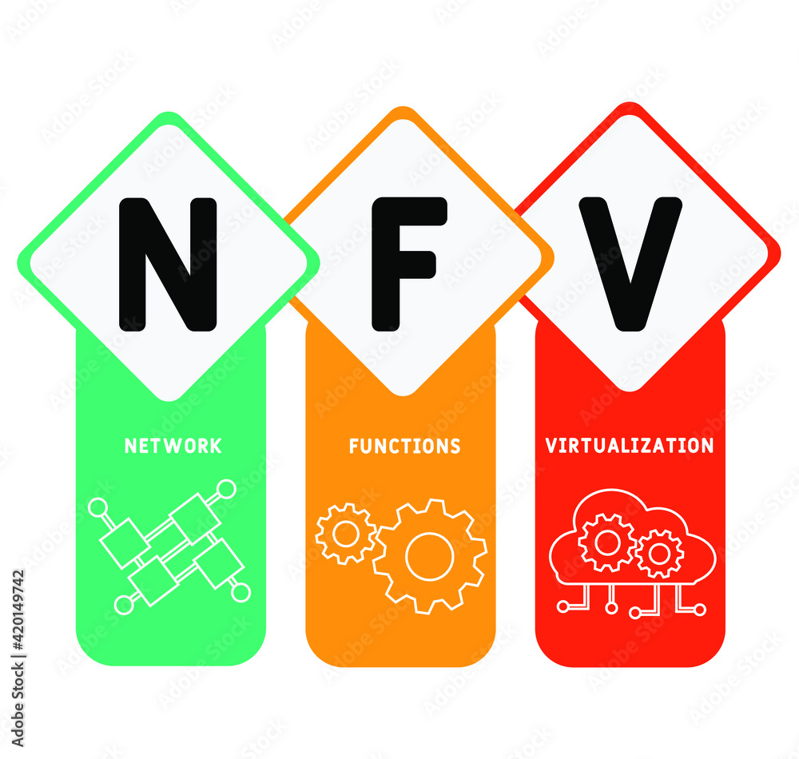
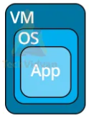


Komunikasi Data &&& Jaringan Komputer
Network Communication
PDS
Computer Vision
Transmisi Data
Pengkodean Data
Teknik Komunikasi Data Digital
Data Link Control
Multiplexing
Switching
Medium Access Sublayer
Multiple Access Control (MAC) Protocols
Network Layer
@ P. Siagian
Multiple Access Control (MAC) Protocols
https://github.com/siagianp
https://www.youtube.com/@AmelOline/videos
https://github.com/amelcharolinesgn2/IoT_simulator-mqtt-NodeRed
github.com/amelcharolinesgn2/ANJAR

Slide 2
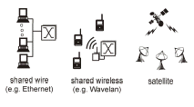
Multiple Access
Broadcast link used in LAN consists of multiple sending and receiving nodes connected to or use a single shared link
Broadcast links Examples

Slide 3
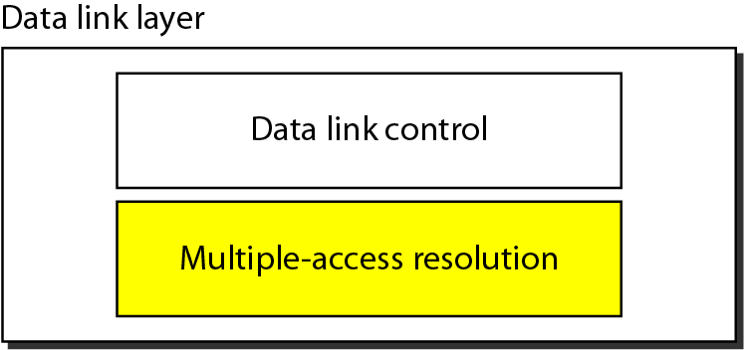
Figure 12.1 Data link layer divided into two functionality-oriented sublayers
Responsible for error and flow control
Link Layer Control (LLC)
Control
MAC
Responsible framing and MAC address and Multiple Access Control

Slide 4
Multiple Access
Problem: When two or more nodes transmit at the same time, their frames will collide and the link bandwidth is wasted during collision
How to coordinate the access of multiple sending/receiving nodes to the shared link???
Solution: We need a protocol to coordinate the transmission of the active nodes
These protocols are called Medium or Multiple Access Control (MAC) Protocols belong to a sublayer of the data link layer called MAC (Medium Access Control)
What is expected from Multiple Access Protocols:
Main task is to minimize collisions in order to utilize the bandwidth by:
Determining when a station can use the link (medium)
what a station should do when the link is busy
what the station should do when it is involved in collision

Slide 5
Terms
Throughput: is the amount of data moved successfully from one place to another in a given time period.
propagation delay: is the amount of time it takes for the head of the signal to travel from the sender to the receiver.

Slide 6
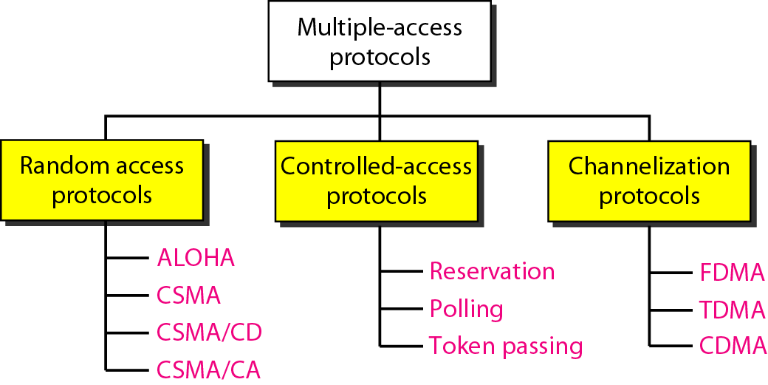
For wireless

Slide 7
Random Access
Random Access (or contention) Protocols:
No station is superior to another station and none is assigned the control over another.
A station with a frame to be transmitted can use the link directly based on a procedure defined by the protocol to make a decision on whether or not to send.

Slide 8
ALOHA

Slide 9
ALOHA Random Access Scheme
It was developed at the University of Hawaii in the early 1970s to connect computers situated on different Hawaiian islands. The computers of the ALOHA network transmit on the same radio channel whenever they have a packet to transmit.
From time-to-time packet transmission will collide, but these can be treated as transmission errors, and recovery can take place by retransmission. When traffic is very light, the probability of collision is very small, and so retransmissions need to be carried out infrequently.
ALOHA scheme requires stations to use a random retransmission time. (This randomization is intended to spread out the retransmission and reduces the likelihood of additional collisions between stations. )
ALOHA is the father of multiple access protocols.

Slide 10
1 Pure ALOHA
All frames from any station are of fixed length (L bits)
Stations transmit at equal transmission time (all stations produce frames with equal frame lengths).
A station that has data can transmit at any time
After transmitting a frame, the sender waits for an acknowledgment for an amount of time (time out) equal to the maximum round-trip propagation delay
Time out= 2* t_{prop}
If no ACK was received, sender assumes that the frame or ACK has been destroyed and resends that frame after it waits for a random amount of time
If station fails to receive an ACK after repeated transmissions, it gives up.
Channel utilization or efficiency or Throughput is the percentage of the transmitted frames that arrive successfully (without collisions)

Slide 11

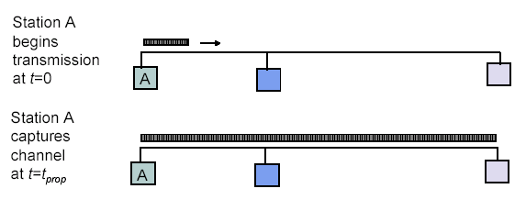
Maximum Propagation Delay
Maximum propagation delay(t_{prop}): time it takes for a bit of a frame to travel between the two most widely separated stations.
The farthest station
Station B receives the first bit of the frame at time t= t_{prop}

Slide 12
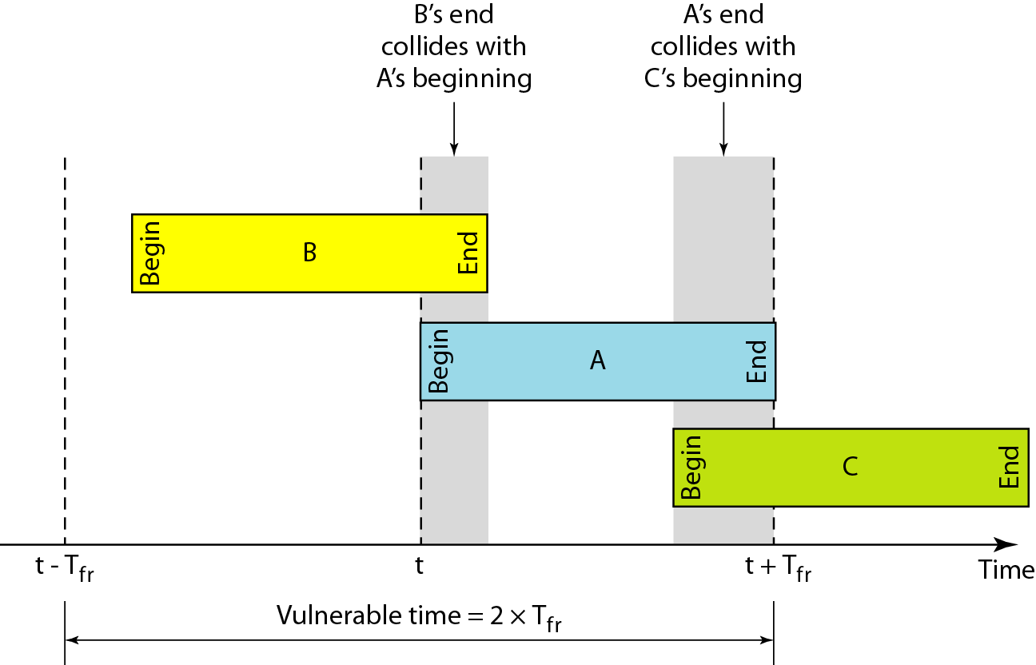
Critical time for pure ALOHA protocol
T_{fr}= Frame Transmission time
If the frame transmission time is T_{fr}, then the vulnerable time is = 2 T_{fr}.
This means no station should send during the T_{fr} before this station starts transmission and no station should start sending during the T-sec period that the current station is sending.

Slide 13
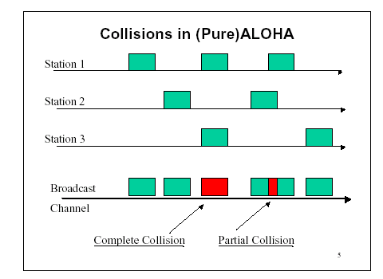
Pure ALOHA
In pure ALOHA, frames are transmitted at completely random times.

Slide 14
2 Slotted ALOHA
Time is divided into slots equal to a frame transmission time (Tfr)
A station can transmit at the beginning of a slot only.
If a station misses the beginning of a slot, it has to wait until the beginning of the next time slot.
A central clock or station informs all stations about the start of a each slot

Slide 15
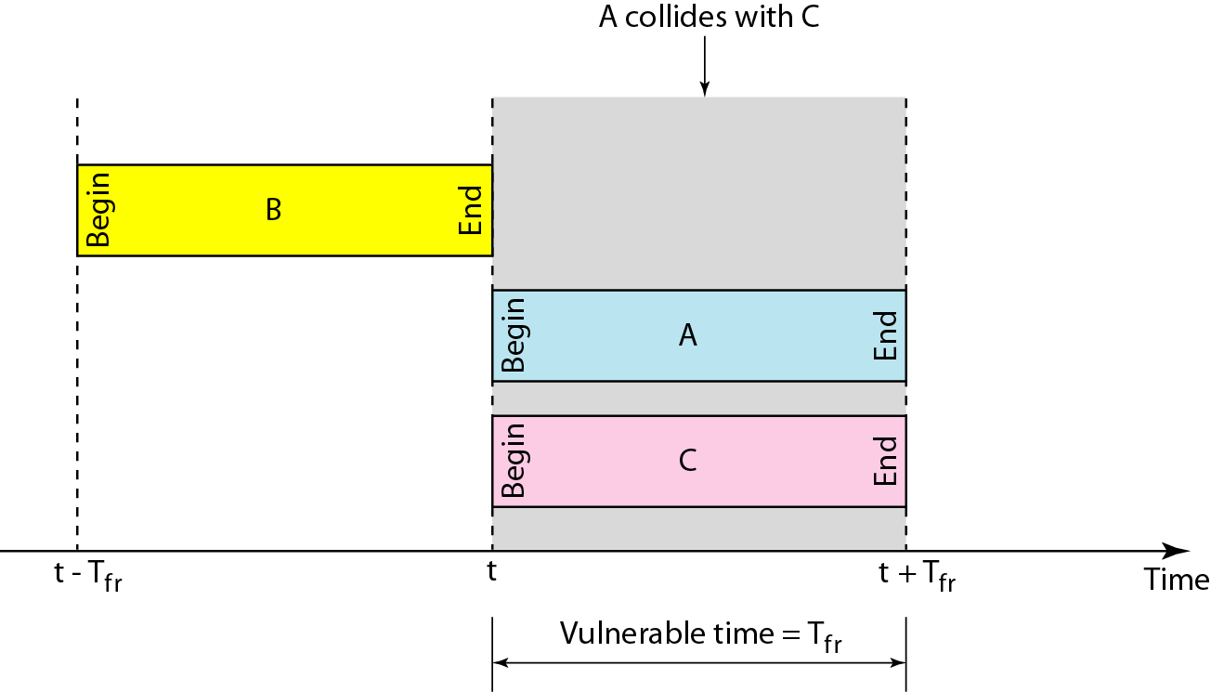
In danger time for slotted ALOHA protocol

Slide 16
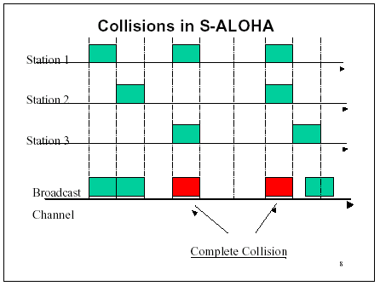
Random Access – Slotted ALOHA

Slide 17
ALOHA
Advantage of ALOHA protocols
A node that has frames to be transmitted can transmit continuously at the full rate of channel (R bps) if it is the only node with frames
Simple to be implemented
No master station is needed to control the medium
Disadvantage
If (M) nodes want to transmit, many collisions can occur and the rate allocated for each node will not be on average R/M bps
This causes low channel utilization

Slide 18
BASIS FOR COMPARISON | Pure ALOHA | Slotted ALOHA
Frame Transmission | The user can transmit the data frame whenever the station has the data to be transmitted. | The user has to wait till the next time slot start, to transmit the data frame.
Time | In Pure ALOHA the time is continuous. | In Slotted ALOHA the time is discrete.
Throughput | The maximum throughput occurs at G = 1/2 which is 18% | The maximum throughput occurs at G = 1 which is 37%.
Danger Time | = 2 T_{fr} | = T_{fr}

Slide 19
Random Access – Carrier Sense Multiple Access (CSMA)

Slide 20
Random Access – Carrier Sense Multiple Access (CSMA)
A user wishing to transmit first listens to the medium to see if another transmission is in progress (carrier sense)
Based on the fact that in LAN propagation time is very small
➔ If a frame was sent by a station, All stations knows immediately so they can wait before start sending
➔ A station with frames to be sent, should sense the medium for the presence of another transmission (carrier) before it starts its own transmission
This can reduce the possibility of collision but it cannot eliminate it.
Collision can only happen when more than one station begin transmitting within a short time (the propagation time period)

Slide 21
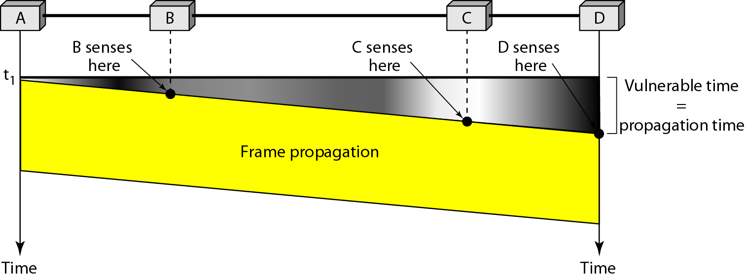
Random Access – Carrier Sense Multiple Access (CSMA)
Vulnerable time for CSMA is the maximum propagation time
The longer the propagation delay, the worse the performance of the protocol because of the above case.

Slide 22
Types of CSMA Protocols
Different CSMA protocols that determine:
What a station should do when the medium is idle?
What a station should do when the medium is busy?
Non-Persistent CSMA
1-Persistent CSMA
p-Persistent CSMA

Slide 23
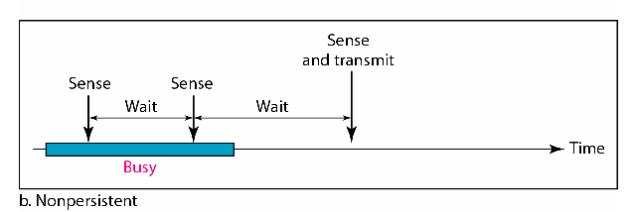
1) Non-persistent CSMA
A station with frames to be sent, should sense the medium:
If medium is idle, transmit; otherwise, go to 2
If medium is busy, (backoff) wait a random amount of time and repeat 1
Performance:
Random delays reduces probability of collisions because two stations with data to be transmitted will wait for different amount of times.
Bandwidth is wasted if waiting time (backoff) is large because medium will remain idle following end of transmission even if one or more stations have frames to send
Random Waiting times
Wasted time

Slide 24
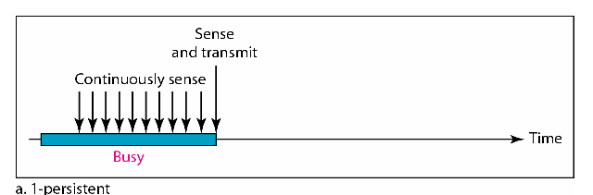
2) 1-persistent CSMA
To avoid idle channel time, 1-persistent protocol used
Station wishing to transmit listens to the medium:
If medium idle, transmit immediately;
If medium busy, continuously listen until medium becomes idle; then transmit immediately with probability 1
Performance
1-persistent stations are selfish
If two or more stations becomes ready at the same time, collision guaranteed

Slide 25
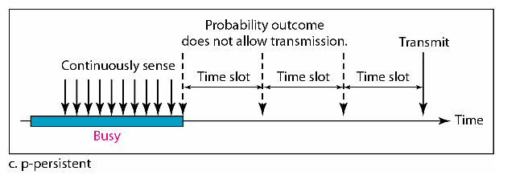
3) P-persistent CSMA
Time is divided to slots where each Time unit (slot) typically equals maximum propagation delay
Station wishing to transmit listens to the medium:
If medium idle,
transmit with probability (p), OR
wait one time unit (slot) with probability (1 – p), then repeat 1.
If medium busy, continuously listen until idle and repeat step 1
Performance
Reduces the possibility of collisions like non-persistent
Reduces channel idle time like 1-persistent

Slide 26
3) P-persistent CSMA
the time slot is usually set to the maximum propagation delay.
as p decreases, stations wait longer to transmit but the number of collisions decreases
Considerations for the choice of p:
(n x p) must be < 1 for stability, where n is maximum number of stations, i.e.,
p < 1/n

Slide 27
CSMA/CD (Collision Detection)
CSMA (all previous methods) has an inefficiency:
If a collision has occurred, the channel is unstable until colliding packets have been fully transmitted
CSMA/CD (Carrier Sense Multiple Access with Collision
Detection) overcomes this as follows:
While transmitting, the sender is listening to medium for collisions.
Sender stops transmission if collision has occurred reducing channel wastage .
CSMA/CD is Widely used for bus topology LANs (IEEE 802.3, Ethernet).

Slide 28
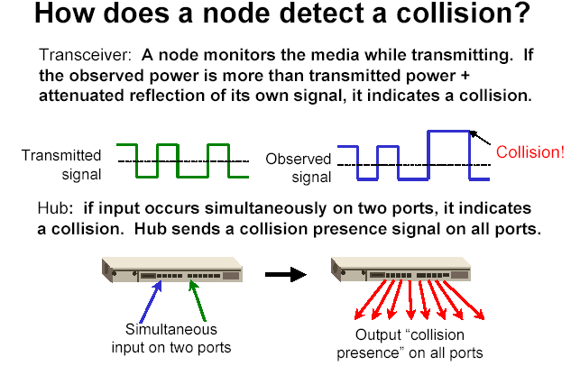
of its own
signal, it means collision occurred

Slide 29
CSMA/CD Protocol
Use one of the CSMA persistence algorithm
(non-persistent, 1-persistent, p-persistent) for transmission
If a collision is detected by a station during its transmission then it should do the following:
Abort transmission and
Transmit a jam signal to notify other stations of collision so that they will discard the transmitted frame also to make sure that the collision signal will stay until detected by the furthest station
After sending the jam signal, backoff (wait) for a random amount of time, then
Transmit the frame again

Slide 30
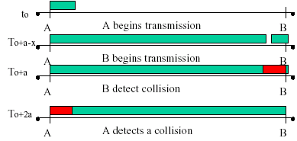
CSMA/CD
Question: How long does it take to detect a collision?
Answer: In the worst case, twice the maximum propagation delay of the medium
Note: a = maximum propagation delay

Slide 31
CSMA/CD
Restrictions of CSMA / CD:
Packet transmission time should be at least as long as the time needed to detect a collision (2 * maximum propagation delay + jam sequence transmission time)
Otherwise, CSMA/CD does not have an advantage over CSMA

Slide 32
Controlled Access or Scheduling

Slide 33
Controlled Access or Scheduling
Provides in order access to shared medium so that every station has chance to transfer (fair protocol)
Eliminates collision completely
Three methods for controlled access:
Reservation
Polling
Token Passing

Slide 34
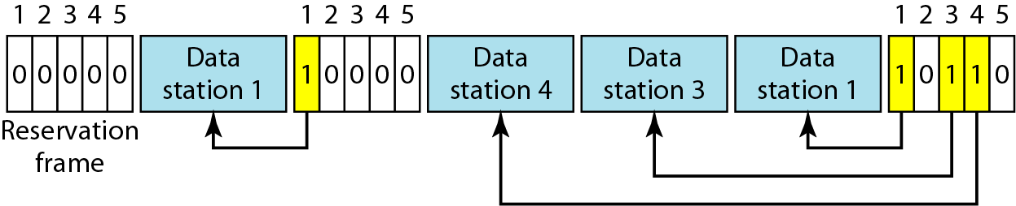
1-Reservation Access Method
Stations take turns transmitting a single frame at a full rate ( R ) bps
Transmissions are organized into variable length cycles
Each cycle begins with a reservation interval that consists of (N) minislots. One minislot for each of the N stations
When a station needs to send a data frame, it makes a reservation in its own minislot.
By listening to the reservation interval, every station knows which stations will transfer frames, and in which order.
The stations that made reservations can send their data frames after the reservation frame.

Slide 35
2- Polling
Stations take turns accessing the medium
Two models: Centralized and distributed polling
Centralized polling
One device is assigned as primary station and the others as secondary stations
All data exchanges are done through the primary
When the primary has a frame to send it sends a select frame that includes the address of the intended secondary
When the primary is ready to receive data it send a Poll frame for each device to ask if it has data to send or not. If yes, data will be transmitted otherwise NAK is sent.
Polling can be done in order (Round-Robin) or based on predetermined order
Distributed polling
No primary and secondary
Stations have a known polling order list which is made based on some protocol
station with the highest priority will have the access right first, then it passes the access right to the next station

Slide 36
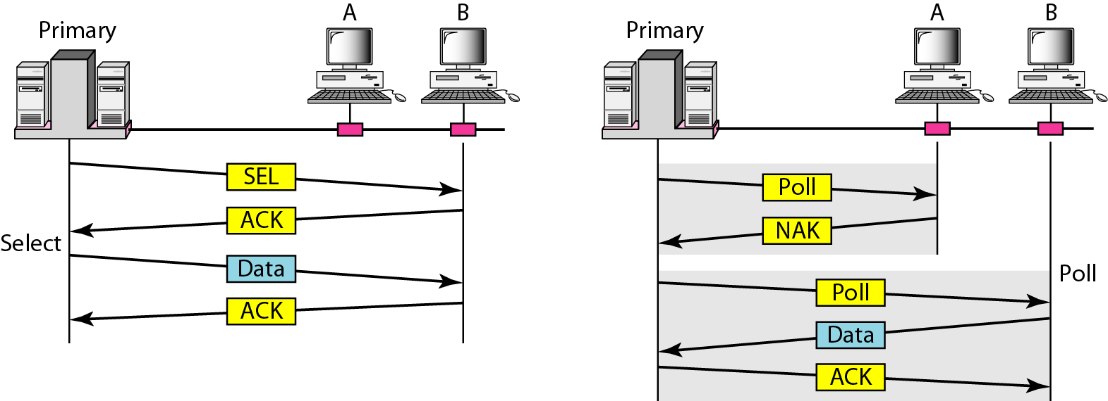
Select and poll functions in polling access method
Primary is sending to Secondary
Secondary is sending to Primary

Slide 37
3- Token-Passing network
Station Interface is in two states:
Listen state: Listen to the arriving bits and check the destination address to see if it is its own address. If yes the frame is copied to the station otherwise it is passed through the output port to the next station.
Transmit state: station captures a special frame called free token and transmits its frames. Sending station is responsible for reinserting the free token into the ring medium and for removing the transmitted frame from the medium.

Slide 38
Channelization

Slide 39
Channelization
Channelization is a multiple-access method in which the available bandwidth of a link is shared in time, frequency, or through code, between different stations. In this section, we discuss three channelization protocols.

Slide 40
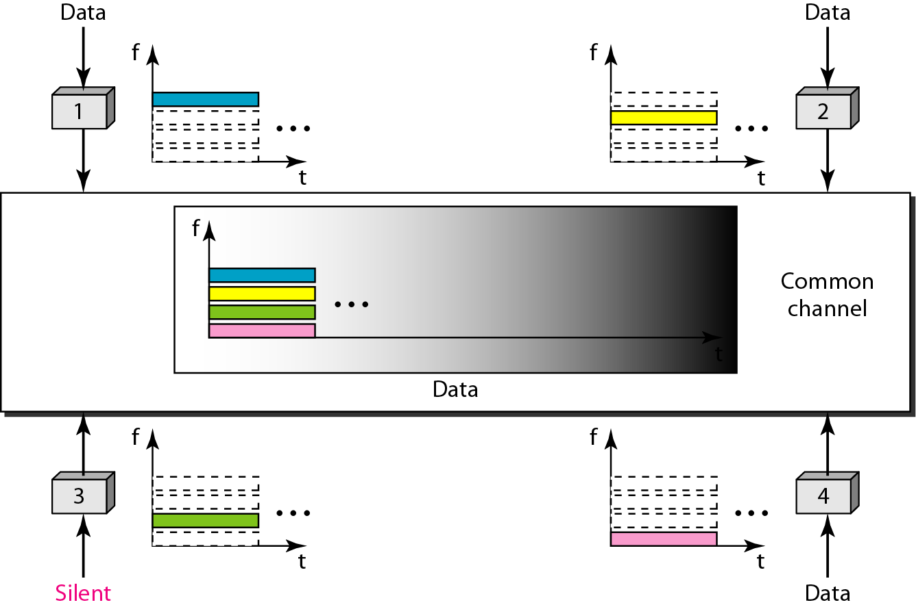
Frequency-division multiple access (FDMA)

Slide 41
FDMA: Frequency Division Multiple Access:
Transmission medium is divided into M separate frequency bands
Each station transmits continuously on the assigned band
A node is limited to an average rate even when it is the only node with frame to be sent

Slide 42
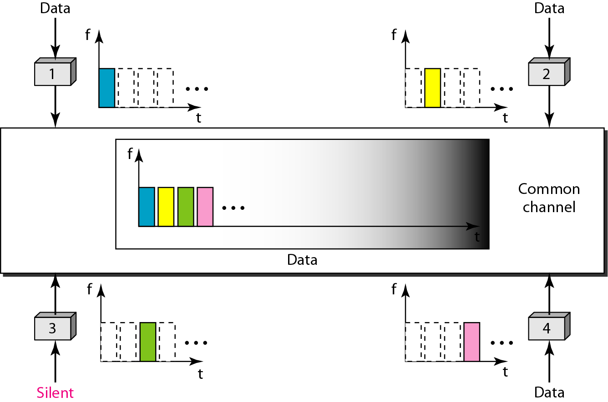
Time-division multiple access (TDMA)

Slide 43
TDMA: Time Division Multiple Access
TDMA: Time Division Multiple Access
The entire bandwidth capacity is a single channel with its capacity shared in time between M stations
A node must always wait for its turn until its slot time arrives even when it is the only node with frames to send

Slide 44
CDMA: Code Division Multiple Access
CDMA: Code Division Multiple Access
In CDMA, one channel carries all transmissions simultaneously
Each station codes its data signal by a specific codes before transmission
The stations receivers use these codes to recover the data for the desired station

Slide 45
HDLC,PPP,Media access control

Slide 46
HDLC - Introduction
High-level Data Link Control
It is used in Datalink layer for multiple data transfer
Bit oriented communication protocol
Used to connect multiple network systems.It applies the ARQ protocol for application and establishes a full-duplex communication channel

Slide 47
HDLC Stations
Primary - establishes and de-establishing primary data channel to share frames in the network known as commands. Performs data management for network
Secondary - Works under command of primary station, and frames issued by this station are known as responses
Combined - Both primary and secondary

Slide 48
HDLC Transfer models
NRM - Normal Response Model (NRM):
This model combines primary and secondary stations in point-to point or multi point network configuration to exchange commands from primary and responses from secondary.
Here only Sender (primary node) and send the data packets. The receiver (secondary) just send the acknowledgement

Slide 49
Transfer model
Asynchronus Balanced Model (ABM):
Combined stations are installed in a point to point configuration for exchange commands and responses in balanced format.
Here both sender and receiver can send data

Slide 50
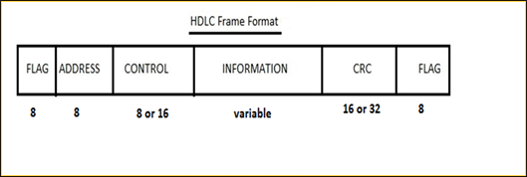
HDLC Frame

Slide 51
Flag Field: It marks the beginning of the frame and termination of the frame. Each frame starts and ends with the flag bit. It is defined by an 8 bit octet sequence 01111110.
Address Field: It encapsulates the receivers address.
Control Field: It contains information about the flow and error control in byte format
Payload/Information Field : This field carries the information that to be transfered
FCS Field : This field stands for Frame check Sequence and acts as error detection field in HDLC protocol
Which includes the 16 bit CRC check bit

Slide 52
Frame models
I- Frames - Information Frame - It is applied to encapsulate the user information from upper layer in the model and then then transmit to network channel. The control bit will 0 indicating that this is a I-Frame model
S-Frame - Supervisory frames - Used for error and data flow control and does not contain the information field in the frame format. First two bits of the control field in 1 and 0 indicating S-Frame
U-Frame - Un-numbered frame - used for system management and exchanging information between the connected network devices

Slide 53
PPP- Introduction
Used to make point to point communication.
WAN protocol
Widely used in broadband communication
Home computers ------------> Servers
Services:
Authentication
Frames - Send frames between the data link layer of one device to another device
Multilink - Newer version support multiple connection

Slide 54
PPP - Frame
Flag : Indicating Beginning and Termination of frame. It is of the form 01111110
Address : Address of the receiver. If we are trying to broadcast something then the address will 11111111
Control : Error control
Protocol : Tells what type of data is being transfered
Payload/Data : Actual data
FCS: Contains the CRC to correct the errors if any.

Slide 55
Byte stuffing
Why byte stuffing ?
It is process adding an extra byte whenever there is a flag sequence appear in payload. It is added so that the receiver will not take it as the end of the frame

Slide 56
Multiple access Control
The Data Link Layer is responsible for transmission of data between two nodes. Its main functions are-
Data Link Control
Multiple Access Control

Slide 57
Data Link control – The data link control is responsible for reliable transmission of message over transmission channel by using techniques like framing, error control and flow control.
Multiple Access Control – If there is a dedicated link between the sender and the receiver then data link control layer is sufficient, however if there is no dedicated link present then multiple stations can access the channel simultaneously. Hence multiple access protocols are required to decrease collision and avoid crosstalk.

Slide 58
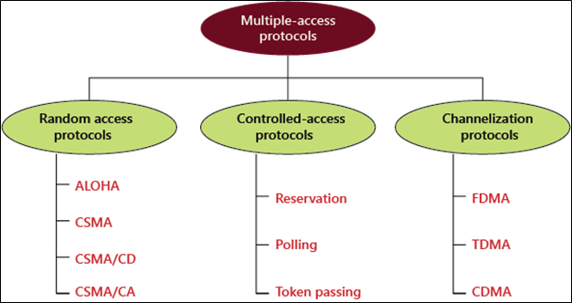
Types of Multiple-access

Slide 59
Random Access Protocols
Random Access Protocol: In this, all stations have same superiority that is no station has more priority than another station. Any station can send data depending on medium’s state( idle or busy)

Slide 60
ALOHA
ALOHA – It was designed for wireless LAN but is also applicable for shared medium. In this, multiple stations can transmit data at the same time and can hence lead to collision and data being garbled.
Pure Aloha: When a station sends data it waits for an acknowledgement. If the acknowledgement doesn’t come within the allotted time then the station waits for a random amount of time called back-off time (Tb) and re-sends the data. Since different stations wait for different amount of time, the probability of further collision decreases.
Slotted Aloha: It is similar to pure aloha, except that we divide time into slots and sending of data is allowed only at the beginning of these slots. If a station misses out the allowed time, it must wait for the next slot. This reduces the probability of collision.

Slide 61
CSMA
CSMA – Carrier Sense Multiple Access ensures fewer collisions as the station is required to first sense the medium (for idle or busy) before transmitting data. If it is idle then it sends data, otherwise it waits till the channel becomes idle.
CSMA/CD – Carrier sense multiple access with collision detection. Stations can terminate transmission of data if collision is detected.
CSMA/CA – Carrier sense multiple access with collision avoidance. The process of collisions detection involves sender receiving acknowledgement signals.

Slide 62
Controlled Access
Reservation
In the reservation method, a station needs to make a reservation before sending data.
The timeline has two kinds of periods:
Reservation interval of fixed time length
Data transmission period of variable frames.
Polling
Polling process is similar to the roll-call performed in class. Just like the teacher, a controller sends a message to each node in turn.
In this, one acts as a primary station(controller) and the others are secondary stations. All data exchanges must be made through the controller.
The message sent by the controller contains the address of the node being selected for granting access.

Slide 63
Token Passing
In token passing scheme, the stations are connected logically to each other in form of ring and access to stations is governed by tokens.
A token is a special bit pattern or a small message, which circulate from one station to the next in some predefined order.

Slide 64
Channelization
Channelization: In this, the available bandwidth of the link is shared in time, frequency and code to multiple stations to access channel simultaneously.
Frequency Division Multiple Access (FDMA) – The available bandwidth is divided into equal bands so that each station can be allocated its own band.
Time Division Multiple Access (TDMA) – In this, the bandwidth is shared between multiple stations. To avoid collision time is divided into slots and stations are allotted these slots to transmit data.

